Slide 1
Embodied AI
- Shaoqin Li

Slide 2
Exploring Loco-mujoco
An open-source imitation learning benchmark created specifically for complex whole-body locomotion tasks (walking, running, squatting, dancing, etc.)
Using MuJoCo (and especially its fast JAX-accelerated version called MJX).
Easy for researchers to train policies (via imitation or RL+imitation) that make robots mimic human or animal motion-capture data in physically-realistic simulation.
https://github.com/robfiras/loco-mujoco
It act as a great platform that has many resources to create your own project

Slide 3
Script Explain
This project is done by PPO with dense reward that measures how closely the policy tracks reference motions. This project consists of two files: Config.yaml for loading environment configurations and experiment.py for setting up environment and apply rl + il training.

Slide 4
PPO
PPO is a reliable reinforcement learning algorithms to learn complex continuous control skills
Belongs to policy gradient methods (taking small gradient steps to push the NN(policy) toward actions that lead t higher long term reward given the current state s)
The idea is that PPO will clip how much the new policy is allowed to differ from the old one.

Slide 5
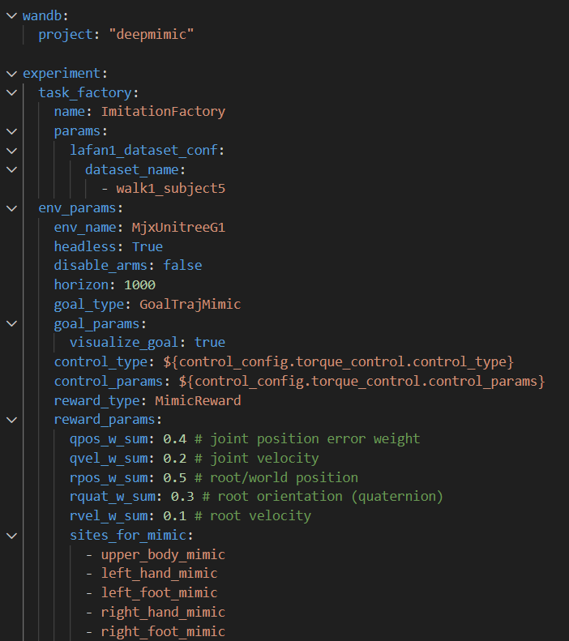
Config
Loads the reference motion from the provided dataset
The MimicReward computes a dense reward at every timestep
It adds up several tracking error terms so that small errors give reward close to 1, large errors give reward close to 0.

Slide 6
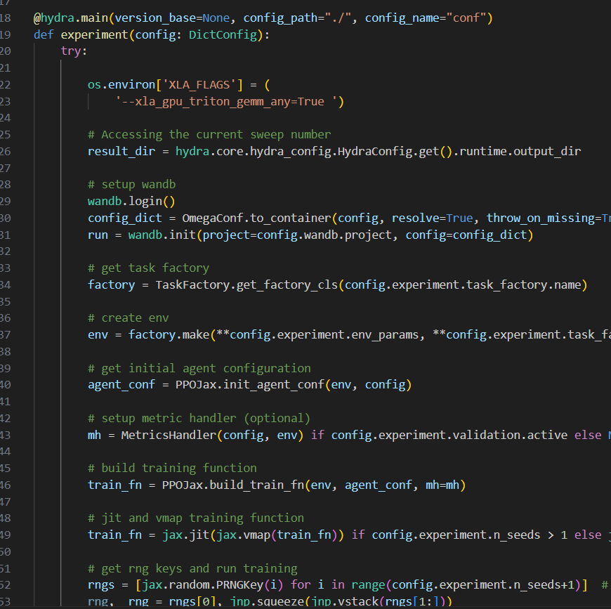
Experiment.py
Act as an “director” of this movie
Setting up all the parameters to the correct setting
Result: Have the video of the trained agent saved

Slide 7

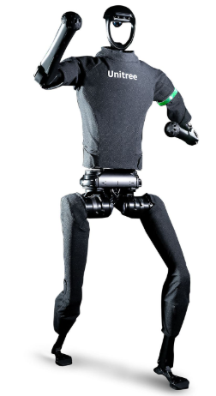
Continue
The RL + IL are done on Unitree H1. So this week I am thinking to change the model to Unitree g1

Slide 8
How to change a model
Recall from the configuration of this project
Config.yaml
Creaeting all the parameters
Experiment.py
Setting up the configurations
Changing model means we will modify both of the files
Config.yaml
Change env_name, site_for_mimic
Experiment.py
Move env vars before JAX imports, add memory management flags for GPU

Slide 9
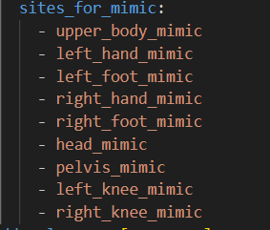
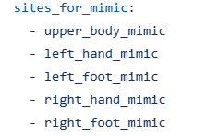
Conf.yaml – key changes

Slide 10
Conf.yaml- hyperparameter changes
Parameter | H1 Value | G1 Value | Rationale
hidden_layers | [512, 256] | [256, 128] | Smaller network → faster iteration
num_envs | 2048 | 16 | Reduce GPU memory for debugging
num_steps | 200 | 64 | Shorter rollouts → quicker feedback
total_timesteps | 300e6 | 1e6 | Minimal training to test functionality
num_minibatches | 32 | 2 | Fewer minibatches → simpler updates
normalize_env | true | false | Disable normalization during debug
debug | false | true | Skip metric logging, faster runs

Slide 11
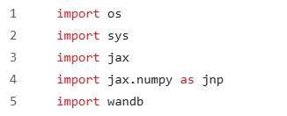
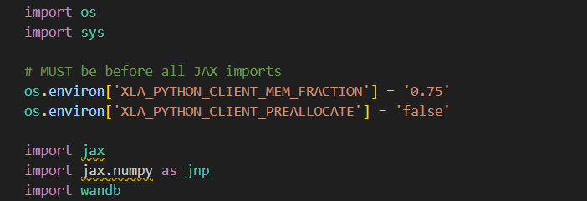
Experiment.py – memory management
To prevent JAX from allocating all GPU memory at once; leaves room for other processes and avoids OOM on smaller GPUs

Slide 12
Problem
I am able to train but with much lower timesteps and env_num which reduce the completeness of the humanoid action
A lot of times my 4GB RAM GPU will run out of memory and shut off

